Slide 1
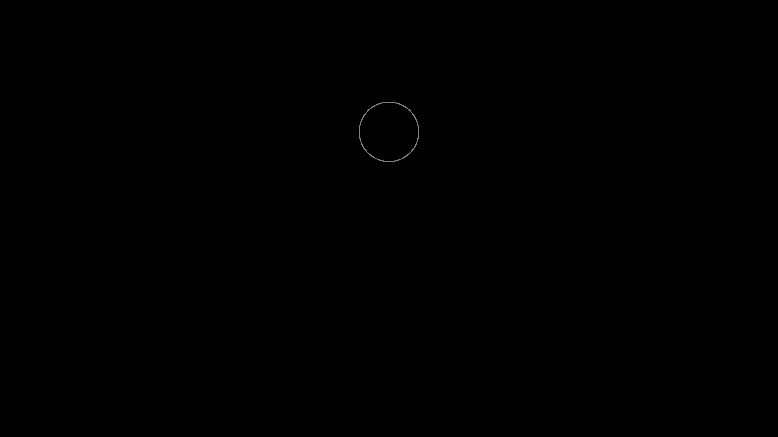
Vector Fields in Multivariable Calculus
Introduction of Vector and Vector Fields
Xianzhuo Ari Yin
Math 151
12/3/2025

Slide 2
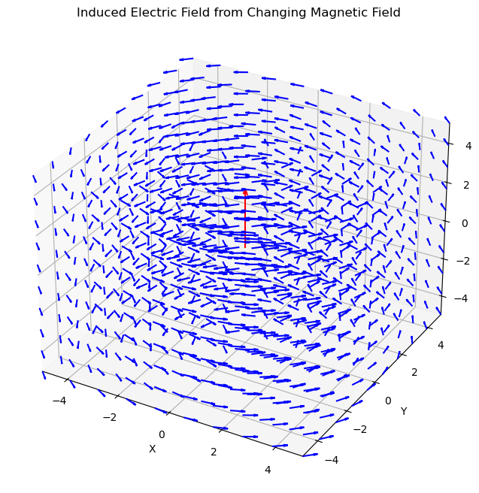
向量场可视化示意图
Why Study Vector Fields?
Core Idea
Many real-world quantities have both magnitude and direction, and they change with spatial position. We use vector fields to model them.
Practical Applications
Wind speed distributions in meteorology
•
Water flow in rivers or oceans
•
Electric and magnetic fields in physics
•

Slide 3
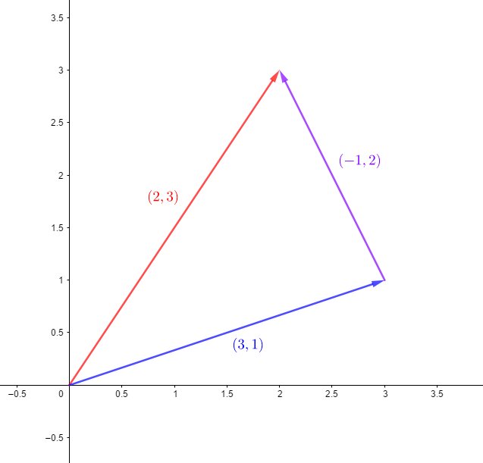
What Is a Vector?
向量场的几何表示
Two-Dimensional Vectors
A vector is a quantity that has both magnitude and direction. In a vector space, it is represented by an ordered pair of numbers.
How to Represent a 2D Vector
It is usually written as (𝑥,𝑦), which gives the vector’s components in the 𝑥- and 𝑦-directions.

Slide 4

Rules for 2D Vector Operations
向量场的几何表示
Addition: Add the components separately.
Subtraction: Subtract the components separately.
Scalar Multiplication: Multiply each component by the scalar.
Magnitude: $\sqrt{x^{2}+y^{2}}$
Dot Product: $x_{1}x_{2}+y_{1}y_{2}$ (used to determine directional relationships)

Slide 5
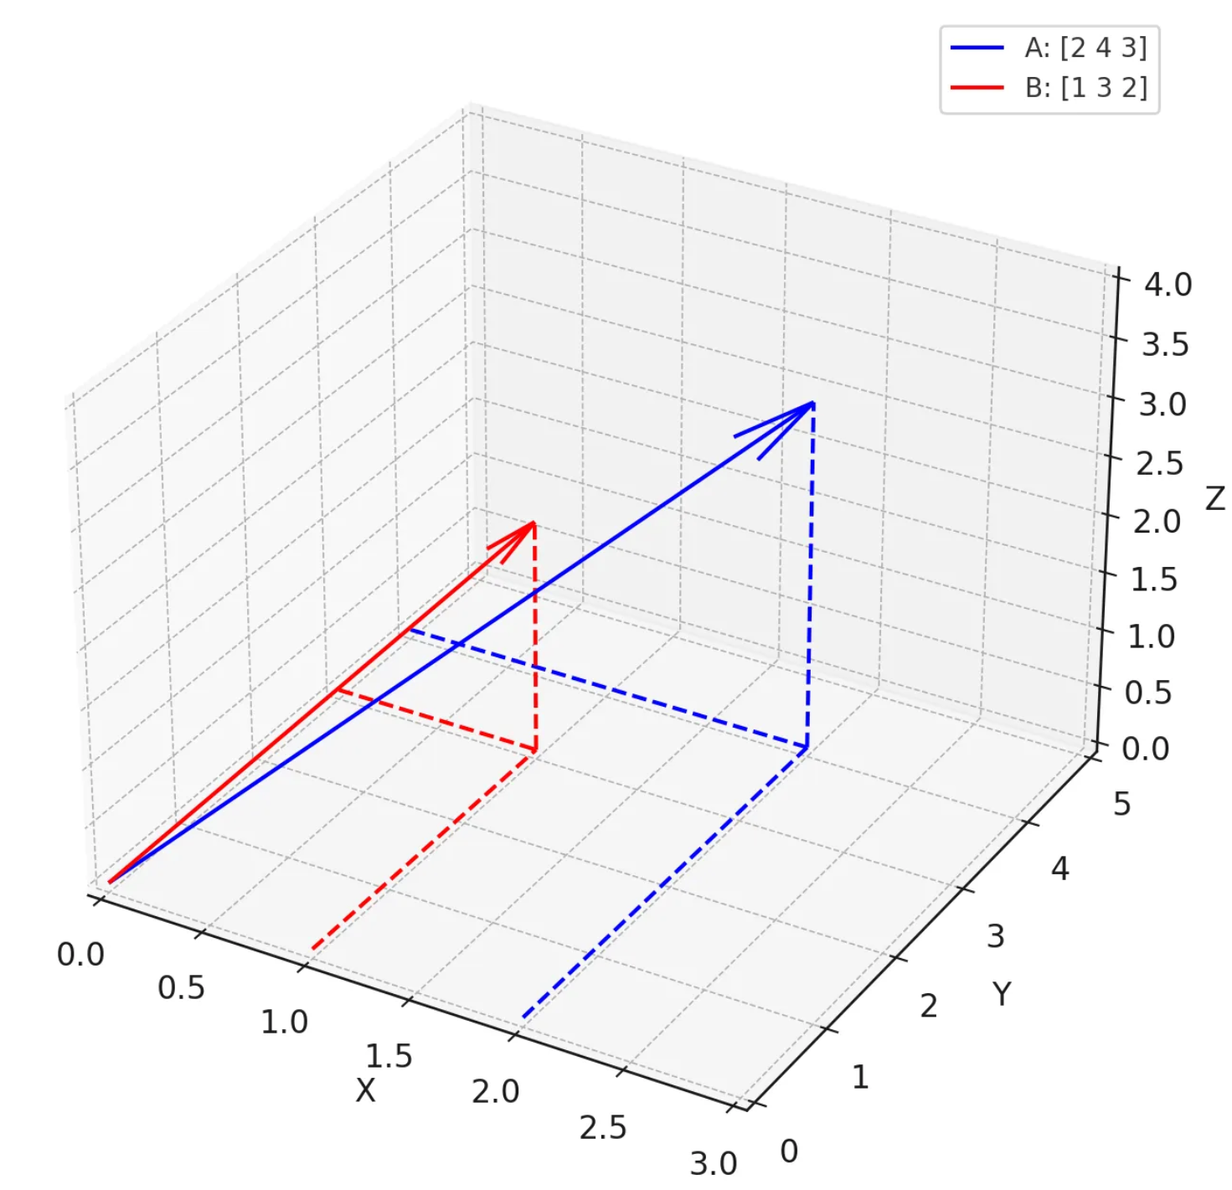
What Is a 3D Vector?
向量场的几何表示
Three-Dimensional Vectors
A vector is a quantity that has both magnitude and direction. In three-dimensional space, a vector is represented by an ordered triple of numbers.
How to Represent a 3D Vector
It is usually written as (𝑥,𝑦,𝑧) which gives the vector’s components in the 𝑥-, 𝑦-, and 𝑧-directions.
The same operation rules also apply to three-dimensional vectors.

Slide 6
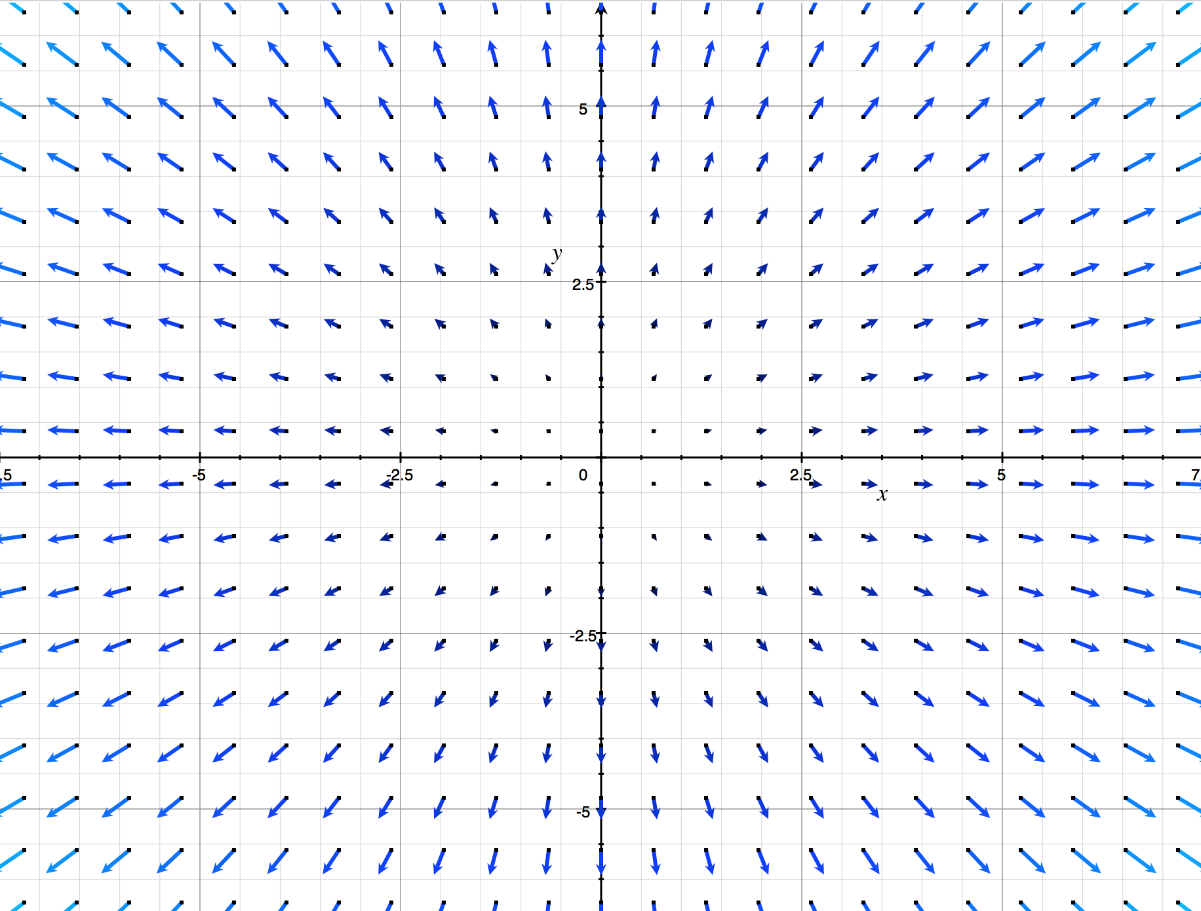

Definition and Representation of 2D Vector Fields
向量场的几何表示
Definition
A vector field is a function that assigns a vector to every point in space.
Two-Dimensional Vector Field
F(x,y)=(P(x,y),Q(x,y))
Interpretation: Each point (𝑥,𝑦) in the plane corresponds to a 2D vector whose components are given by the functions 𝑃 and 𝑄.
Example

Slide 7




Several Ways to Represent 2D Vector Fields
常向量场
（Constant Vector Field）
径向向量场
（Radial Vector Field）
旋转向量场 / 切向向量场
（Rotational / Tangential Vector Field）

Slide 8
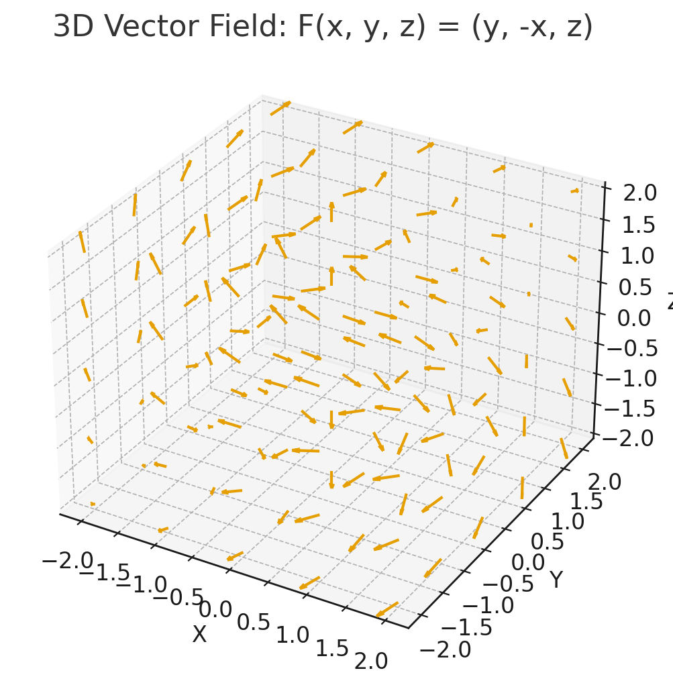

Definition and Representation of 3D Vector Fields
向量场的几何表示
Definition
A vector field is a function that assigns a vector to every point in space.
Three-Dimensional Vector Field
F(x,y,z)=(P(x,y,z),Q(x,y,z),R(x,y,z))
Interpretation: Each point (𝑥,𝑦,𝑧) in space corresponds to a 3D vector whose components are given by the functions 𝑃, 𝑄, and 𝑅.
Example

Slide 9


Several Ways to Represent 3D Vector Fields
旋转向量场 / 切向向量场
（Rotational / Tangential Vector Field）
常向量场
（Constant Vector Field）
径向向量场
（Radial Vector Field）
Around x-axis
Around y-axis
Around z-axis

Slide 10
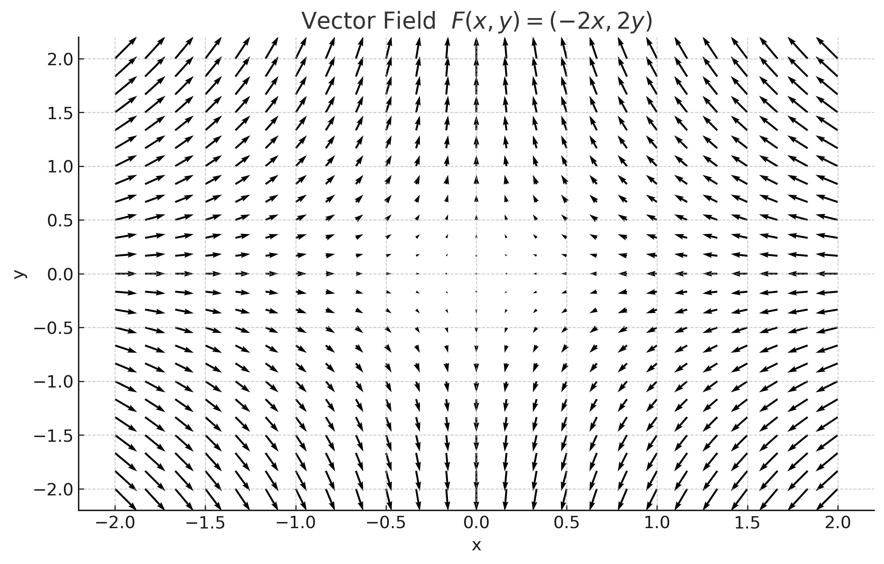
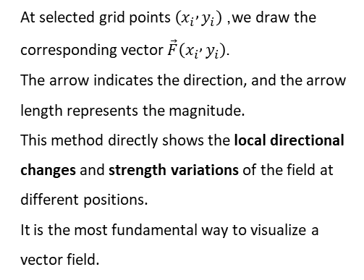
Visualization of Vector Fields
1. Vector (Arrow) Plot
At selected grid points $\left(x_{i} , y_{i}\right)$, we draw the corresponding vector $\vec{F}\left(x_{i} , y_{i}\right)$.
The arrow indicates the direction, and the arrow length represents the magnitude.
This method directly shows the local directional changes and strength variations of the field at different positions.
It is the most fundamental way to visualize a vector field.
Visualization is essential for understanding vector fields — it is a core tool.

Slide 11
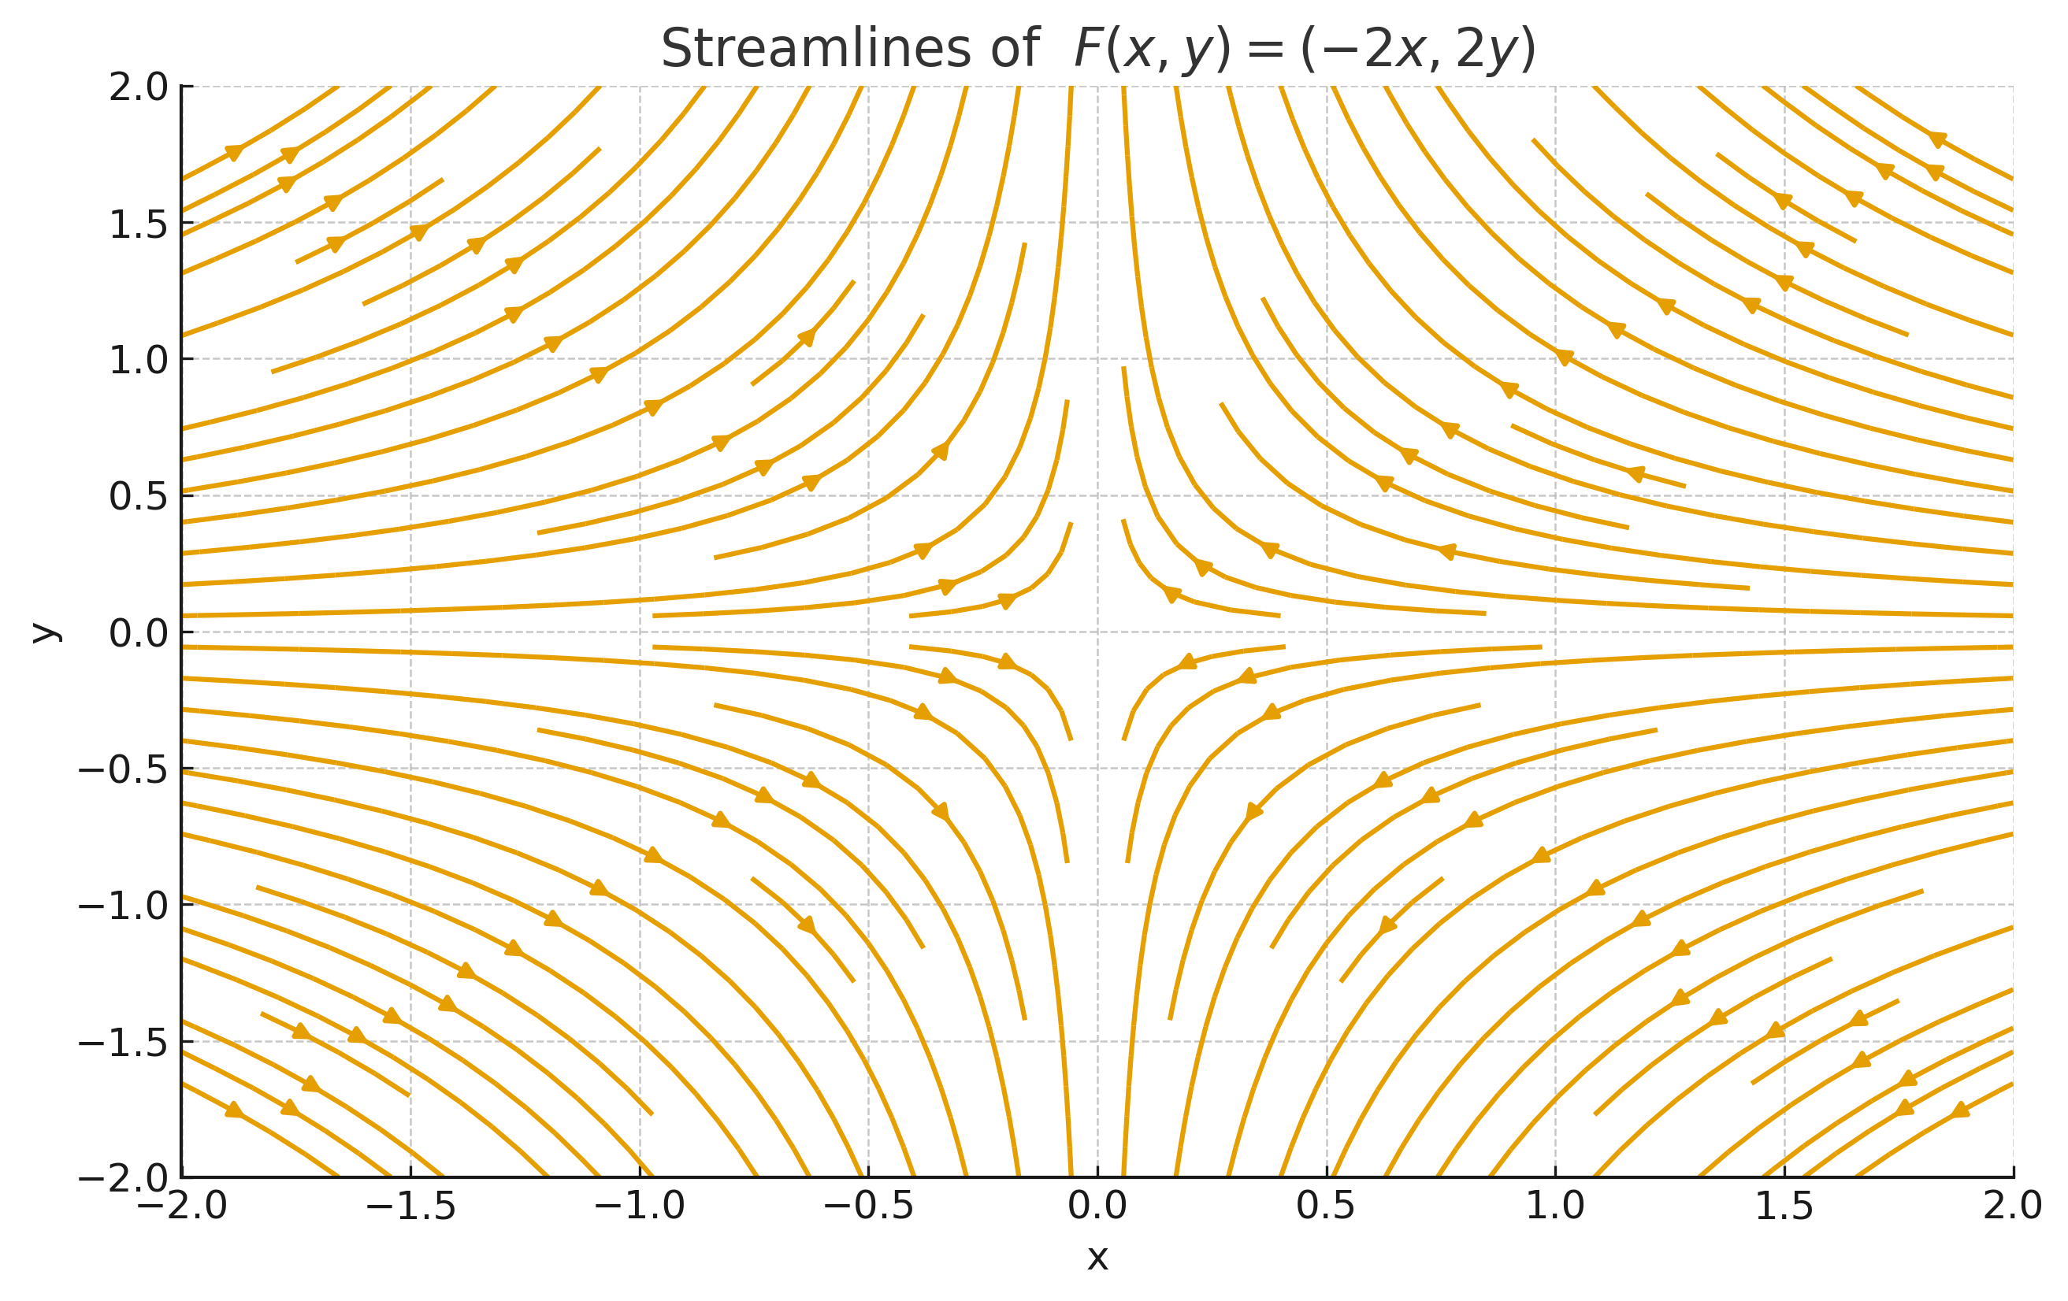
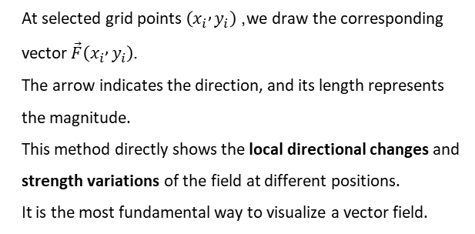
Visualization of Vector Fields
2. Streamlines
At selected grid points $\left(x_{i} , y_{i}\right)$, we draw the corresponding vector $\vec{F}\left(x_{i} , y_{i}\right)$.
The arrow indicates the direction, and its length represents the magnitude.
This method directly shows the local directional changes and strength variations of the field at different positions.
It is the most fundamental way to visualize a vector field.
Visualization is essential for understanding vector fields.

Slide 12
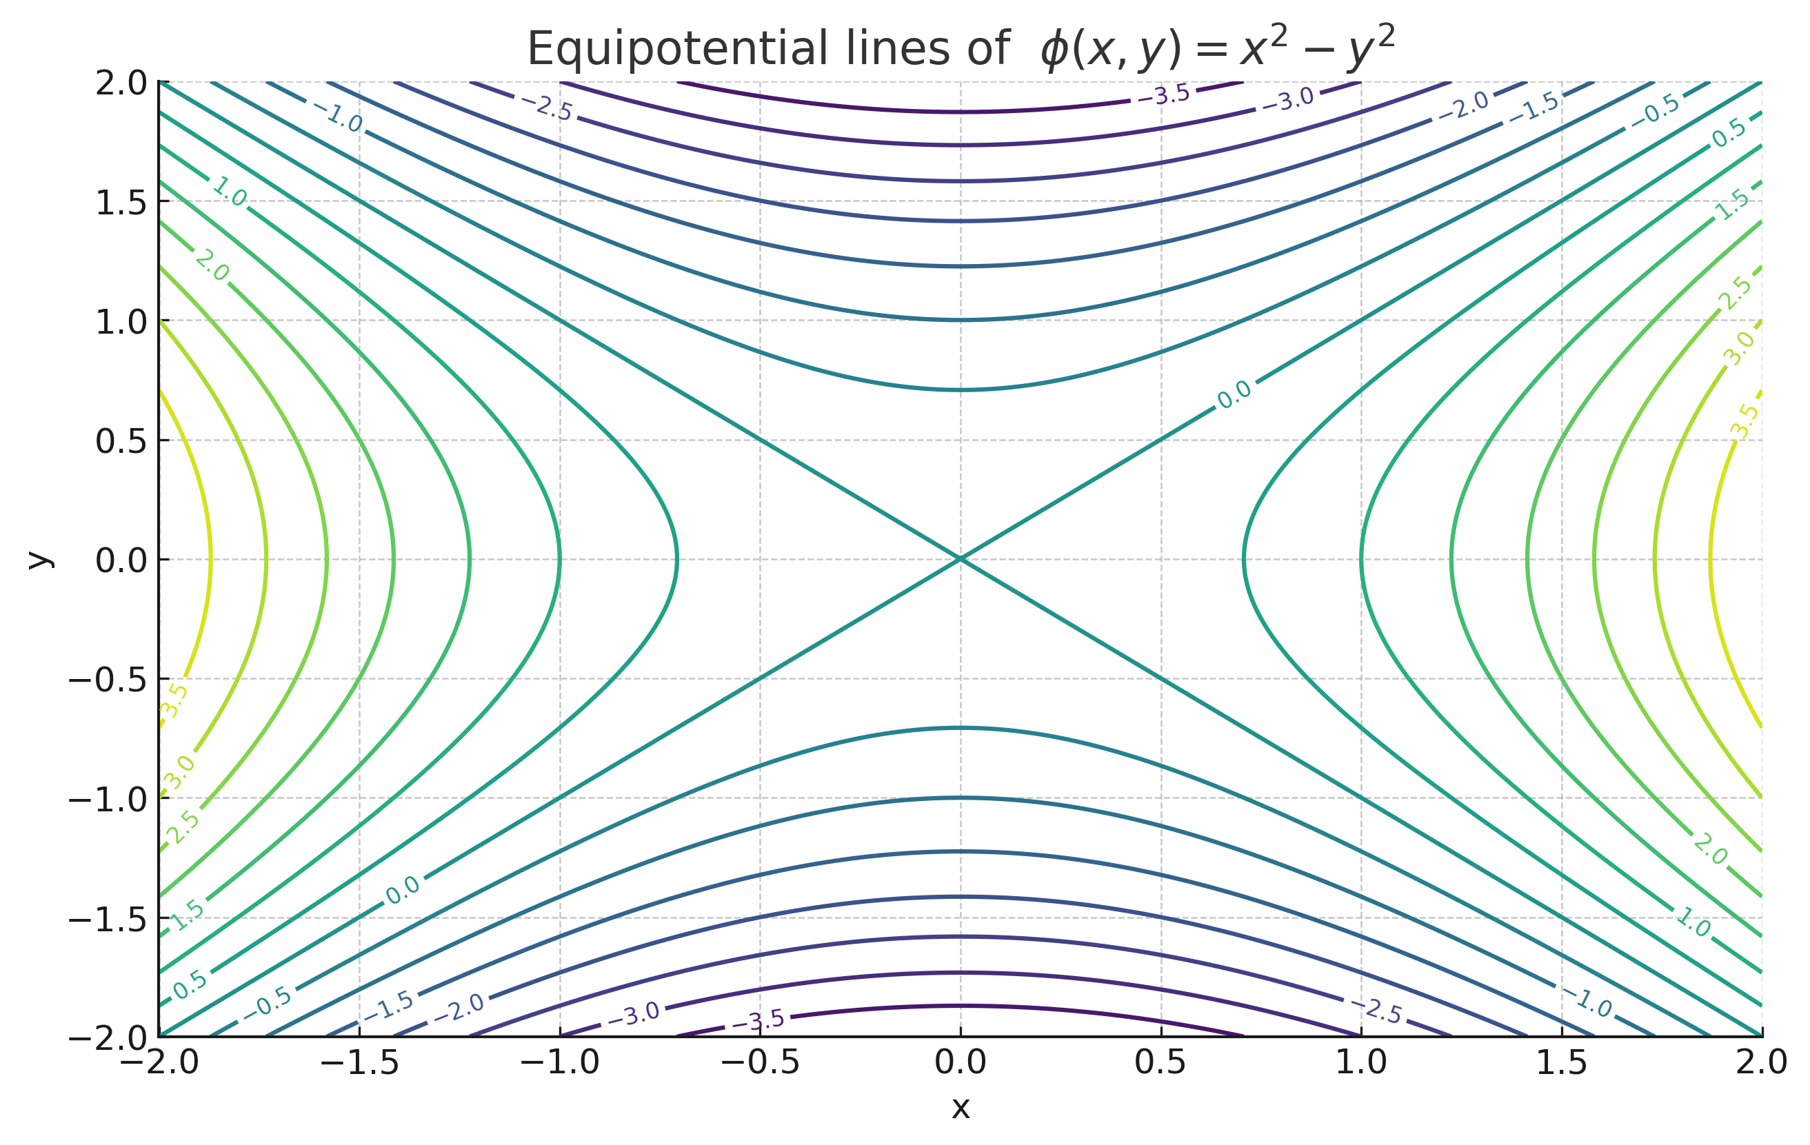
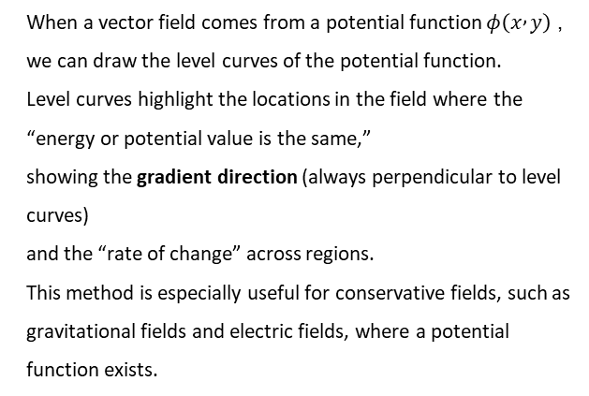
向量场的可视化
3. Equipotential Lines (Level Curves)
When a vector field comes from a potential function $φ\left(x , y\right)$, we can draw the level curves of the potential function.
Level curves highlight the locations in the field where the “energy or potential value is the same,”
showing the gradient direction (always perpendicular to level curves)
and the “rate of change” across regions.
This method is especially useful for conservative fields, such as gravitational fields and electric fields, where a potential function exists.

Slide 13
Thank you for your listening!
谢谢！

